Slide 1

Speech enhancement based on adaptive wavelet de-noising on multitaper spectrum
Authors: Bertozzi Iacopo, Bianciardi Alessandro, Fierro Leonardo, Nodari Stefano Master Degree in Communication Technologies and Multimedia
Course of Advanced Methods for Information Representation A.Y. 2017/2018

Slide 2
SUMMARY
Classical speech enhancement algorithms require a good estimation of the short-time power spectrum.
Periodogram methods: large variance, ‘musical noise’ after enhancement.
MTS: Multi-Taper spectrum estimators
Wavelet denoising of the logarithmic MTS via thresholding:
Constant / Universal thresholding not appropriate
Adaptive thresholding: describe how the variance of the noise in log spectrum varies according to underlying signal magnitude in power spectrum and refine the MTS with an appropriate threshold.

Slide 3
MTS ESTIMATION
Accurate estimation of the a priori SNR critical to eliminate the musical noise
Direct spectrum estimation via Hamming windowing reduce the bias but does not reduce the variance of the spectral estimate
MTS estimator (Thomson, 1982): reduce the variance by computing a small number of direct spectrum estimators, each with a different window (taper), and then average the spectral estimates
Tapers are chosen to be pairwise orthogonal and properly designed to prevent leakage

Slide 4
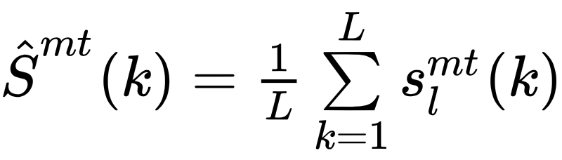
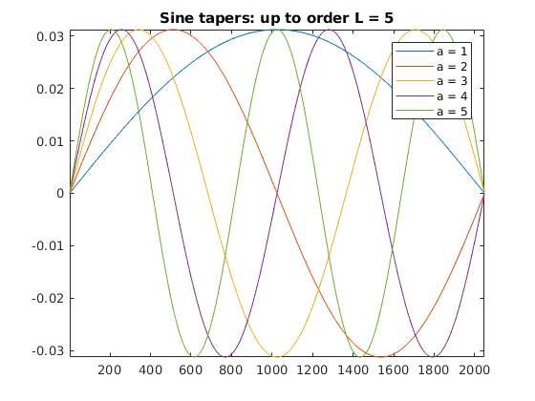
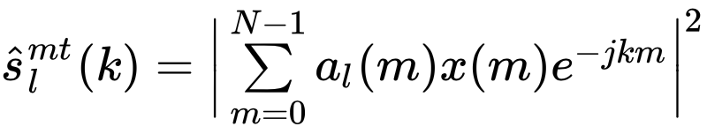
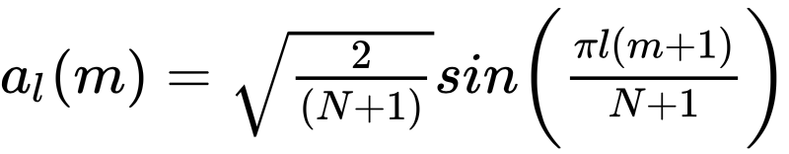
MTS ESTIMATION
As compared to the traditional windowing methods, the variance induced by the estimator can be reduced by a factor of L, where L is the number of tapers. A good design implements orthonormal tapers, for example the sine tapers:

Slide 5
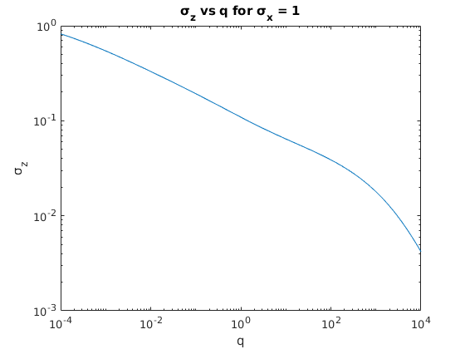
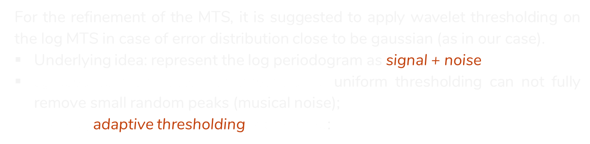


DWT + THRESHOLDING
For the refinement of the MTS, it is suggested to apply wavelet thresholding on the log MTS in case of error distribution close to be gaussian (as in our case).
Underlying idea: represent the log periodogram as signal + noise
$σ_{z}$ used as main factor for thresholding: uniform thresholding can not fully remove small random peaks (musical noise);
instead, adaptive thresholding is preferred:
n: random variable (noise)
q: deterministic parameter (speech)
$z=log⁡(n+q)$
$${∂=σ}_{z} \sqrt{2 logN}$$
One per each level of DWT

Slide 6
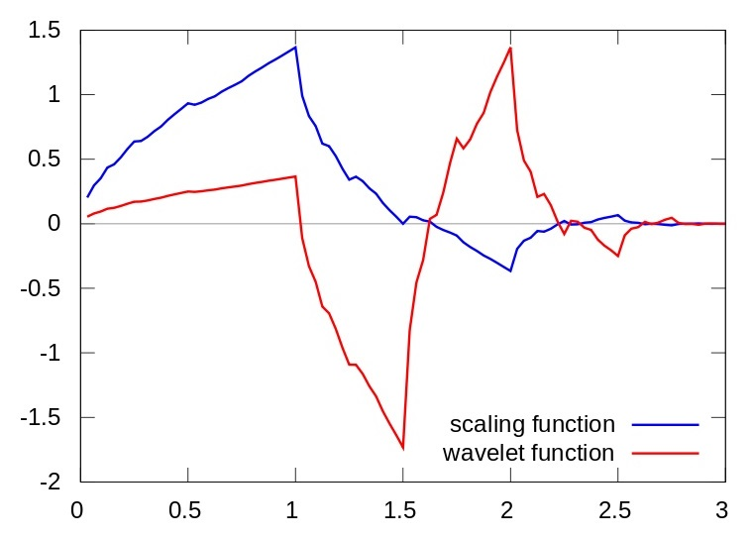
Discrete Wavelet Transform
4th order Daubechies
Least asymmetric orthogonal wavelet
LA(4) wavelet family
Threshold retrieved from the DWT on MTS, applied to the DWT on log MTS

Slide 7
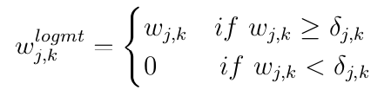
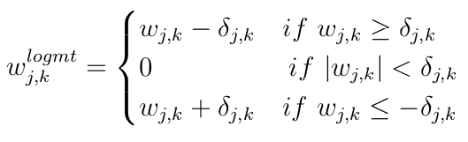
Thresholding
Hard Thresholding
Soft Thresholding

Slide 8
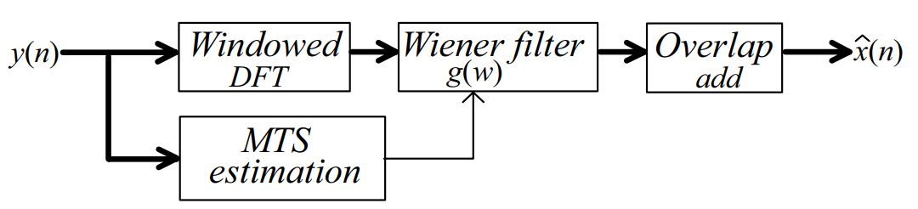
WIENER FILTER
Produces an estimate of a desired random process by linear time-invariant (LTI) filtering of an observed noisy process, assuming known stationary noise spectra, and additive noise.
Minimizes MSE between the estimated random process and the desired process.
Gain function dependent on MT signal and noise spectra, applied to STFT of the noisy signal.

Slide 9

ALGORITHM INITIALIZATION
TIMIT Dataset: 630 speakers, 8 different dialects, 10 sentences each
Sample frequency: 16 KHz
Window length: 2048 samples
Noise: gaussian, additive, in band (filtered)
SNR: tested down to 0 dB
Wavelet decomposition down to level 5
Local window size in thresholding: 2 samples

Slide 10
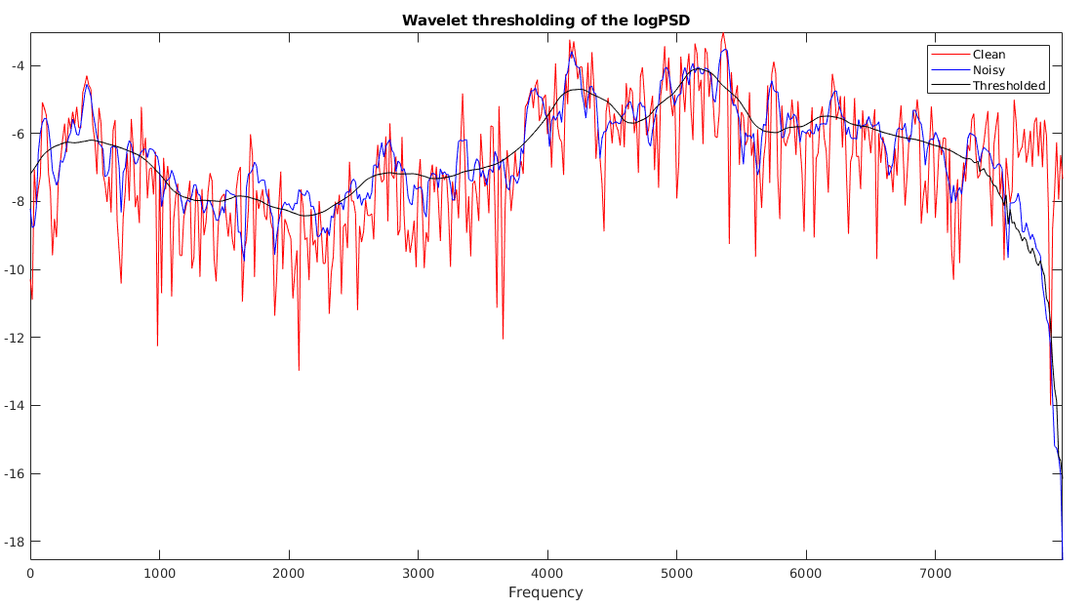
EXPERIMENTAL RESULTS

Slide 11
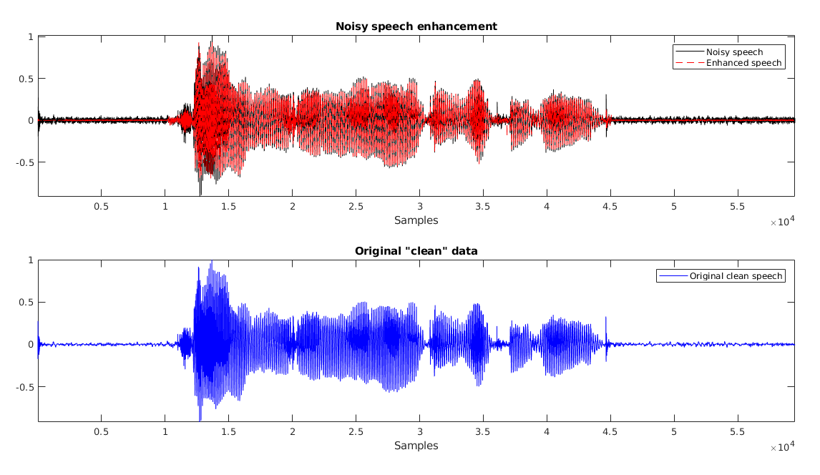
EXPERIMENTAL RESULTS

Slide 12

EXPERIMENTAL RESULTS
Noisy speech
Denoised
Low-variance noise:
High-variance noise

Slide 13
CONCLUSIONS
Optimal results in terms of noise reduction and waveform recovery!
Quite fast: computational time ≤ 2 · audio duration
Some distortions introduced when going down near SNR = 0 dB.
Possible improvements:
Different windowing for STFT
Test behaviour with particular types of noise
SURE Thresholding
Thank you!

